Slide 1
Linguistic Approaches to Intervention
Nick Riches
(1) Multimodal approaches
Definition
Use of shape and colour Use of gesture
Linguistic Approaches to Intervention
(2) Difficulty gradients
What are difficulty gradients?
Difficulty gradients
Nick Riches
Newcastle University
(3) Lexical variation within slots
Variation versus no variation Skewed distributions
May 12, 2020
(4) Other psycholinguistic approaches
Distributed learning Active learning
Conclusion Bibliography
1 / 38

Slide 2
Linguistic Approaches to Intervention
Nick Riches
(1) Multimodal approaches
Definition
Use of shape and colour Use of gesture
(1) Multimodal approaches
(2) Difficulty gradients
(2) Difficulty gradients
What are difficulty gradients?
Difficulty gradients
(3) Lexical variation within slots
(4) Other psycholinguistic approaches
(3) Lexical variation within slots
Variation versus no variation Skewed distributions
Conclusion Bibliography
(4) Other psycholinguistic approaches
Distributed learning Active learning
Conclusion
Bibliography
1 / 38

Slide 3
Definition
Linguistic Approaches to Intervention
Nick Riches
(1) Multimodal approaches
Definition
Use of shape and colour Use of gesture
(2) Difficulty gradients
What are difficulty gradients?
Difficulty gradients
Recruit non-linguistic representations (e.g. shape, colour and gesture) to support language learning.
(3) Lexical variation within slots
Variation versus no variation Skewed distributions
(4) Other psycholinguistic approaches
Distributed learning Active learning
Conclusion Bibliography
2 / 38

Slide 4
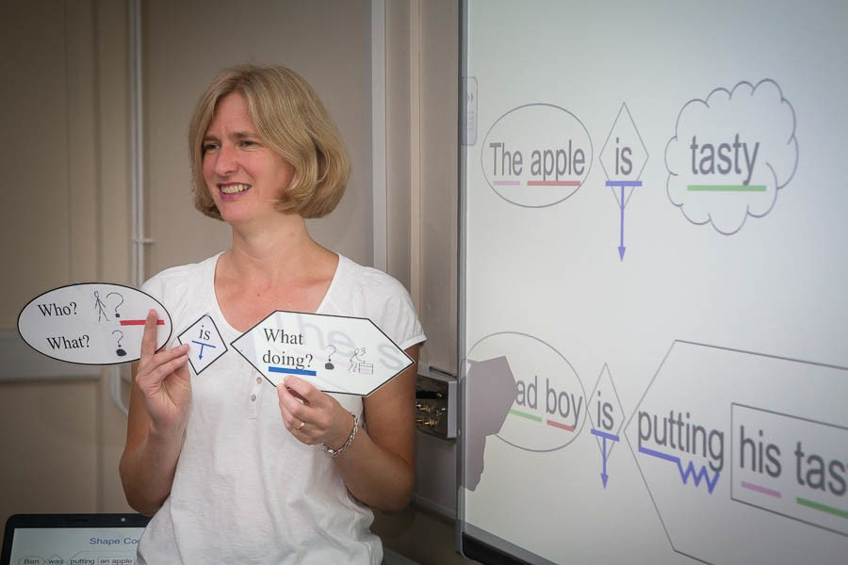
Use of shape and colour
Linguistic Approaches to Intervention
Nick Riches
“Shape coding” is a very popular system devised by Susan Ebbels.
Based on ‘Colourful semantics’ (Dorothy Bryan)
(1) Multimodal approaches
Definition
Use of shape and colour Use of gesture
Difficulty gradients
What are difficulty gradients?
Difficulty gradients
Lexical variation within slots
Variation versus no variation Skewed distributions
Other psycholinguistic approaches
Distributed learning Active learning
Conclusion Bibliography
3 / 38

Slide 5
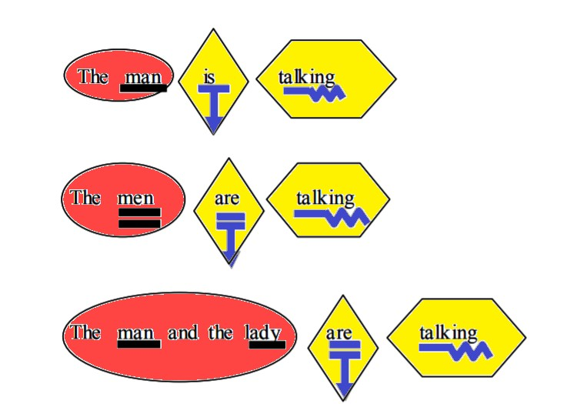
Use of shape and colour
Linguistic Approaches to Intervention
Nick Riches
Multimodal approaches
Definition
Use of shape and colour Use of gesture
Difficulty gradients
What are difficulty gradients?
Difficulty gradients
Lexical variation within slots
Variation versus no variation Skewed distributions
Other psycholinguistic approaches
Distributed learning Active learning
Conclusion Bibliography
4 / 38

Slide 6
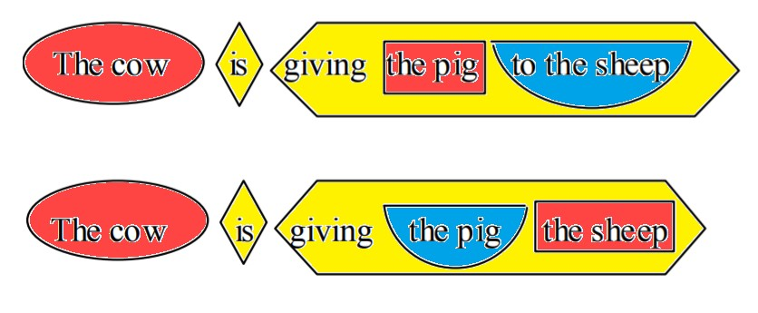
Use of shape and colour
Linguistic Approaches to Intervention
Nick Riches
Multimodal approaches
Definition
Use of shape and colour Use of gesture
Difficulty gradients
What are difficulty gradients?
Difficulty gradients
Lexical variation within slots
Variation versus no variation Skewed distributions
Other psycholinguistic approaches
Distributed learning Active learning
Conclusion Bibliography
4 / 38

Slide 7
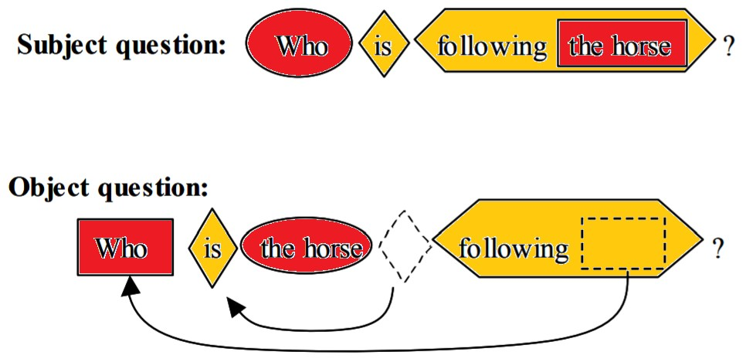
Use of shape and colour
Linguistic Approaches to Intervention
Nick Riches
Multimodal approaches
Definition
Use of shape and colour Use of gesture
Difficulty gradients
What are difficulty gradients?
Difficulty gradients
Lexical variation within slots
Variation versus no variation Skewed distributions
Other psycholinguistic approaches
Distributed learning Active learning
Conclusion Bibliography
4 / 38

Slide 8
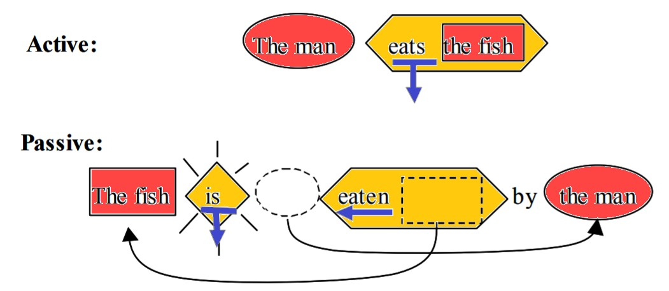
Use of shape and colour
Linguistic Approaches to Intervention
Nick Riches
Multimodal approaches
Definition
Use of shape and colour Use of gesture
Difficulty gradients
What are difficulty gradients?
Difficulty gradients
Lexical variation within slots
Variation versus no variation Skewed distributions
Other psycholinguistic approaches
Distributed learning Active learning
Conclusion Bibliography
4 / 38

Slide 9
Use of shape and colour
Linguistic Approaches to Intervention
Nick Riches
(1) Multimodal approaches
Definition
Use of shape and colour Use of gesture
Movement processes, e.g. auxiliary movement in questions, are graphically demonstrated
Subject-verb agreement is graphically demonstrated
Phrase structure / constituent structure is graphically
demonstrated
Some conventions are ‘iconic’, e.g. double-underlining to show plural
(2) Difficulty gradients
What are difficulty gradients?
Difficulty gradients
(3) Lexical variation within slots
Variation versus no variation Skewed distributions
(4) Other psycholinguistic approaches
Distributed learning Active learning
Conclusion
Bibliography
5 / 38

Slide 10
Use of shape and colour
Linguistic Approaches to Intervention
Nick Riches
(1) Multimodal approaches
Definition
Use of shape and colour Use of gesture
(2) Difficulty gradients
What are difficulty gradients?
Difficulty gradients
Strong evidence base, but most data collected from older children (11;0 and above)
(3) Lexical variation within slots
Variation versus no variation Skewed distributions
(4) Other psycholinguistic approaches
Distributed learning Active learning
Conclusion Bibliography
6 / 38

Slide 11
Use of gesture
Linguistic Approaches to Intervention
Nick Riches
(1) Multimodal approaches
Definition
Use of shape and colour Use of gesture
(2) Difficulty gradients
What are difficulty gradients?
Difficulty gradients
Co-speech gestures (i.e. gestures occuring at the same time as speech) can boost children’s comprehension of complex sentences (Theakston et al. 2014)
(3) Lexical variation within slots
Variation versus no variation Skewed distributions
(4) Other psycholinguistic approaches
Distributed learning Active learning
Conclusion Bibliography
7 / 38

Slide 12
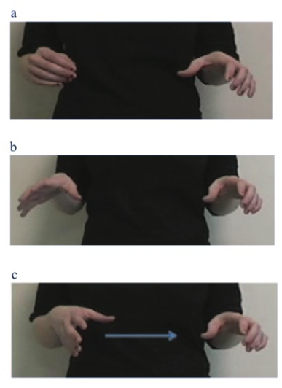
Use of gesture
Linguistic Approaches to Intervention
Nick Riches
Multimodal approaches
Definition
Use of shape and colour Use of gesture
Difficulty gradients
What are difficulty gradients?
Difficulty gradients
Lexical variation within slots
Variation versus no variation Skewed distributions
Other psycholinguistic approaches
Distributed learning Active learning
Conclusion Bibliography
8 / 38

Slide 13
Linguistic Approaches to Intervention
Nick Riches
(1) Multimodal approaches
Definition
Use of shape and colour Use of gesture
(1) Multimodal approaches
(2) Difficulty gradients
(2) Difficulty gradients
What are difficulty gradients?
Difficulty gradients
(3) Lexical variation within slots
(4) Other psycholinguistic approaches
(3) Lexical variation within slots
Variation versus no variation Skewed distributions
Conclusion Bibliography
(4) Other psycholinguistic approaches
Distributed learning Active learning
Conclusion
Bibliography
8 / 38

Slide 14
What are difficulty gradients?
Linguistic Approaches to Intervention
Nick Riches
(1) Multimodal approaches
Definition
Use of shape and colour Use of gesture
Recap on factors affecting processing difficulty in complex sentences
(2) Difficulty gradients
What are difficulty gradients?
Difficulty gradients
Position of embedding (middle of sentence versus end)
Presence / absence of animacy cues
Discourse properties of Noun Phrases, e.g. do we use a Noun or Pronoun in subject position.
(3) Lexical variation within slots
Variation versus no variation Skewed distributions
(4) Other psycholinguistic approaches
Distributed learning Active learning
Conclusion
Bibliography
9 / 38

Slide 15
What are difficulty gradients?
Linguistic Approaches to Intervention
Nick Riches
(1) Multimodal approaches
Definition
Use of shape and colour Use of gesture
(2) Difficulty gradients
What are difficulty gradients?
Difficulty gradients
(1) The boy [ that pushed the girl ] was naughty
(2) The boy pushed the girl [ that was naughty ]
(3) Lexical variation within slots
Variation versus no variation Skewed distributions
(4) Other psycholinguistic approaches
Distributed learning Active learning
Conclusion
Bibliography

Slide 16
What are difficulty gradients?
Linguistic Approaches to Intervention
Nick Riches
(1) Multimodal approaches
Definition
Use of shape and colour Use of gesture
(3)
The boy
that
the rock
squashed
was large
ANIMATE
INANIMATE
(2) Difficulty gradients
What are difficulty gradients?
Difficulty gradients
(4)
The car
that
the man
drove
was very fast
(3) Lexical variation within slots
Variation versus no variation Skewed distributions
INANIMATE
ANIMATE
(4) Other psycholinguistic approaches
Distributed learning Active learning
(5)
The cow
that
the pig
chased
was spotted
ANIMATE
ANIMATE
Conclusion
Bibliography

Slide 17
What are difficulty gradients?
Linguistic Approaches to Intervention
Nick Riches
(1) Multimodal approaches
Definition
Use of shape and colour Use of gesture
(2) Difficulty gradients
What are difficulty gradients?
Difficulty gradients
(6)
The cow
that he chased was spotted
PRONOUN
(3) Lexical variation within slots
Variation versus no variation Skewed distributions
FULL NOUN PHRASE
(4) Other psycholinguistic approaches
Distributed learning Active learning
Conclusion
Bibliography

Slide 18
What are difficulty gradients?
Linguistic Approaches to Intervention
STATE PASSIVE (Israel et al., 2000)
Car broken. (Adam 2;4)
Pumpkin stuck. (Nina 2;1)
Now it’s fixed. (Peter 2;0)
Nick Riches
(1) Multimodal approaches
Definition
Use of shape and colour Use of gesture
(2) Difficulty gradients
What are difficulty gradients?
Difficulty gradients
(3) Lexical variation within slots
Variation versus no variation Skewed distributions
(4) Other psycholinguistic approaches
Distributed learning Active learning
EVENT PASSIVE
Conclusion
(12)
That dolly’s gonna be washed cause she’s dirty (Nina, 3;2)
Bibliography

Slide 19
What are difficulty gradients?
Linguistic Approaches to Intervention
STATE PASSIVE (Israel et al., 2000)
Car broken. (Adam 2;4)
Pumpkin stuck. (Nina 2;1)
Now it’s fixed. (Peter 2;0)
INTERMEDIATE PASSIVE (participle ambivalent between an event and state)
I want them opened (Nina, 3;0)
She doesn’t need it cut (Nina, 3;1) EVENT PASSIVE
That dolly’s gonna be washed cause she’s dirty (Nina, 3;2)
Nick Riches
(1) Multimodal approaches
Definition
Use of shape and colour Use of gesture
(2) Difficulty gradients
What are difficulty gradients?
Difficulty gradients
(3) Lexical variation within slots
Variation versus no variation Skewed distributions
(4) Other psycholinguistic approaches
Distributed learning Active learning
Conclusion
Bibliography

Slide 20
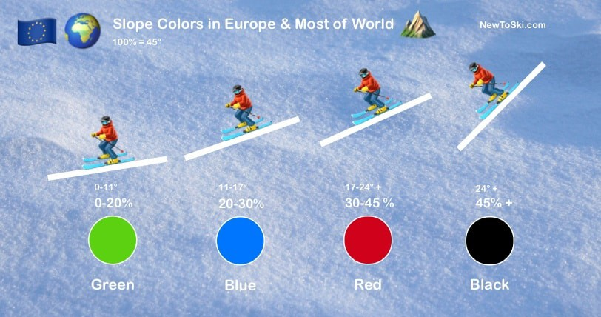
Difficulty gradients
Linguistic Approaches to Intervention
We can manipulate these factors to make a difficulty gradient?
Nick Riches
(1) Multimodal approaches
Definition
Use of shape and colour Use of gesture
Difficulty gradients
What are difficulty gradients?
Difficulty gradients
Lexical variation within slots
Variation versus no variation Skewed distributions
Other psycholinguistic approaches
Distributed learning Active learning
Conclusion Bibliography

Slide 21
Difficulty gradients
Linguistic Approaches to Intervention
Nick Riches
Multimodal approaches
Definition
Use of shape and colour Use of gesture
Difficulty gradients
What are difficulty gradients?
Difficulty gradients
Lexical variation within slots
Variation versus no variation Skewed distributions
 | No cluster | Cluster
Easy semantics (natural endpoint) | fried /d/ | baked /kd/
Difficult semantics (no natural endpoint) | hummed /d/ | laughed /ft/
Van Horne et al. (2017) - much greater learning in a complex-first condition.
(4) Other psycholinguistic approaches
Distributed learning Active learning
Conclusion
Bibliography
15 / 38

Slide 22
Difficulty gradients
Linguistic Approaches to Intervention
Nick Riches
(1) Multimodal approaches
Definition
Use of shape and colour Use of gesture
Why do we need to make items complex?
Exemplar theory: children have immature representations, or ”exemplars”
These are initially overly-specific, and will become more abstract over time.
Language-impaired children may be overly dependent on exemplars (Dell and Chang, 2013)
(2) Difficulty gradients
What are difficulty gradients?
Difficulty gradients
(3) Lexical variation within slots
Variation versus no variation Skewed distributions
(4) Other psycholinguistic approaches
Distributed learning Active learning
Conclusion
Bibliography

Slide 23
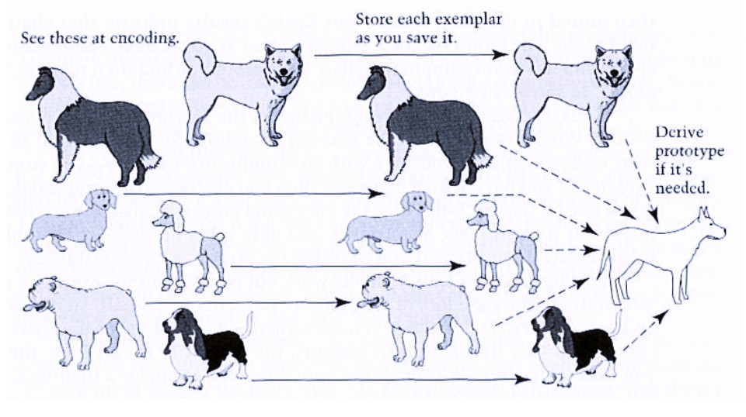
Difficulty gradients
Linguistic Approaches to Intervention
Nick Riches
Multimodal approaches
Definition
Use of shape and colour Use of gesture
Difficulty gradients
What are difficulty gradients?
Difficulty gradients
Lexical variation within slots
Variation versus no variation Skewed distributions
Other psycholinguistic approaches
Distributed learning Active learning
Conclusion
Bibliography

Slide 24
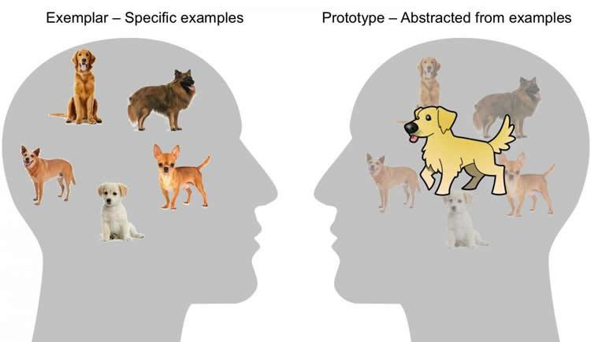
Difficulty gradients
Linguistic Approaches to Intervention
Nick Riches
Multimodal approaches
Definition
Use of shape and colour Use of gesture
Difficulty gradients
What are difficulty gradients?
Difficulty gradients
Lexical variation within slots
Variation versus no variation Skewed distributions
Other psycholinguistic approaches
Distributed learning Active learning
Conclusion Bibliography

Slide 25
Difficulty gradients
Linguistic Approaches to Intervention
Nick Riches
Multimodal approaches
Definition
Use of shape and colour Use of gesture
Difficulty gradients
What are difficulty gradients?
Difficulty gradients
Lexical variation within slots
Variation versus no variation Skewed distributions
Adult representation
Verb + ed
= AN EVENT TAKING PLACE IN THE PAST
Child representation
Verb + ed
= A COMPLETED EVENT
(4) Other psycholinguistic approaches
Distributed learning Active learning
Conclusion
Bibliography

Slide 26
Difficulty gradients
Linguistic Approaches to Intervention
Nick Riches
(1) Multimodal approaches
Definition
Use of shape and colour Use of gesture
(2) Difficulty gradients
What are difficulty gradients?
Difficulty gradients
A general rule of thumb is that it may be beneficial to “stretch” children by introducing difficult items as long as these are not overwhelmingly difficult. It is a fine balancing act.
(3) Lexical variation within slots
Variation versus no variation Skewed distributions
(4) Other psycholinguistic approaches
Distributed learning Active learning
Conclusion
Bibliography

Slide 27
Linguistic Approaches to Intervention
Nick Riches
(1) Multimodal approaches
Definition
Use of shape and colour Use of gesture
(1) Multimodal approaches
(2) Difficulty gradients
(2) Difficulty gradients
What are difficulty gradients?
Difficulty gradients
(3) Lexical variation within slots
(4) Other psycholinguistic approaches
(3) Lexical variation within slots
Variation versus no variation Skewed distributions
Conclusion Bibliography
(4) Other psycholinguistic approaches
Distributed learning Active learning
Conclusion
Bibliography

Slide 28
Variation versus no variation
Linguistic Approaches to Intervention
Nick Riches
(1) Multimodal approaches
Definition
Use of shape and colour Use of gesture
1.
2.
3.
’s dacking king it
’s dacking
The dog
He | ’s dac
The cat
the ball
(2) Difficulty gradients
What are difficulty gradients?
Difficulty gradients
the pencil
4. He ’s dacking it
(3) Lexical variation within slots
Variation versus no variation Skewed distributions
1.
2.
3.
4.
’s dacking ’s dacking ’s dacking ’s dacking
The dog
The dog
The dog
The dog
the ball
the ball
the ball
the ball
(4) Other psycholinguistic approaches
Distributed learning Active learning
Conclusion
Bibliography

Slide 29
Variation versus no variation
Linguistic Approaches to Intervention
Nick Riches
(1) Multimodal approaches
Definition
Use of shape and colour Use of gesture
(2) Difficulty gradients
What are difficulty gradients?
Difficulty gradients
Children (aged 2;6) trained in a high variability condition demonstrated better learning of the transitive construction (Childers & Tomasello, 2001)
(3) Lexical variation within slots
Variation versus no variation Skewed distributions
(4) Other psycholinguistic approaches
Distributed learning
Active learning
Conclusion
Bibliography

Slide 30
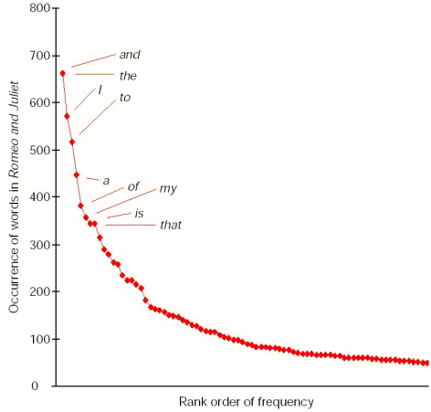
Skewed distributions
Linguistic Approaches to Intervention
Nick Riches
Multimodal approaches
Definition
Use of shape and colour Use of gesture
Difficulty gradients
What are difficulty gradients?
Difficulty gradients
Lexical variation within slots
Variation versus no variation Skewed distributions
Other psycholinguistic approaches
Distributed learning Active learning
Conclusion Bibliography

Slide 31
Skewed distributions
Linguistic Approaches to Intervention
Nick Riches
gave
showed sent promised
told
delivered told
promised
(1) Multimodal approaches
Definition
Use of shape and colour Use of gesture
(2) Difficulty gradients
What are difficulty gradients?
Difficulty gradients
DIR. OB
IND. OB
SUBJ.
(3) Lexical variation within slots
Variation versus no variation Skewed distributions
(4) Other psycholinguistic approaches
Distributed learning Active learning
Conclusion
The postman
delivered
the letter
to the woman
Bibliography

Slide 32
Skewed distributions
Linguistic Approaches to Intervention
Casenhiser & Goldberg, 2005
Nick Riches
(1) Multimodal approaches
Definition
Use of shape and colour Use of gesture
moopoed x 2
vakoed x 2
sutoed x 2
keboed x 1
fegoed x 1
(2) Difficulty gradients
What are difficulty gradients?
Difficulty gradients
The rabbit the hat
(3) Lexical variation within slots
Variation versus no variation Skewed distributions
moopoed x 4
vakoed x 1
sutoed x 1
keboed x 1
fegoed x 1
(4) Other psycholinguistic approaches
Distributed learning Active learning
The rabbit the hat
Conclusion
Bibliography

Slide 33
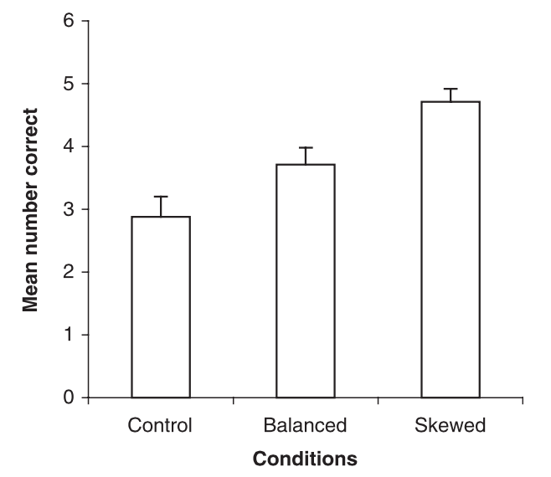
Skewed distributions
Linguistic Approaches to Intervention
Nick Riches
Multimodal approaches
Definition
Use of shape and colour Use of gesture
Difficulty gradients
What are difficulty gradients?
Difficulty gradients
Lexical variation within slots
Variation versus no variation Skewed distributions
Other psycholinguistic approaches
Distributed learning Active learning
Conclusion Bibliography
26 / 38

Slide 34
Linguistic Approaches to Intervention
Nick Riches
(1) Multimodal approaches
Definition
Use of shape and colour Use of gesture
(1) Multimodal approaches
(2) Difficulty gradients
(2) Difficulty gradients
What are difficulty gradients?
Difficulty gradients
(3) Lexical variation within slots
(4) Other psycholinguistic approaches
(3) Lexical variation within slots
Variation versus no variation Skewed distributions
Conclusion Bibliography
(4) Other psycholinguistic approaches
Distributed learning Active learning
Conclusion
Bibliography
26 / 38

Slide 35
Distributed learning
Linguistic Approaches to Intervention
Nick Riches
Learning episode
(1) Multimodal approaches
Definition
Use of shape and colour Use of gesture
1 day
(2) Difficulty gradients
What are difficulty gradients?
Difficulty gradients
“Massed” condition
(3) Lexical variation within slots
Variation versus no variation Skewed distributions
1 week
(4) Other psycholinguistic approaches
Distributed learning Active learning
“Spaced” or “distributed” condition
Conclusion
Bibliography

Slide 36
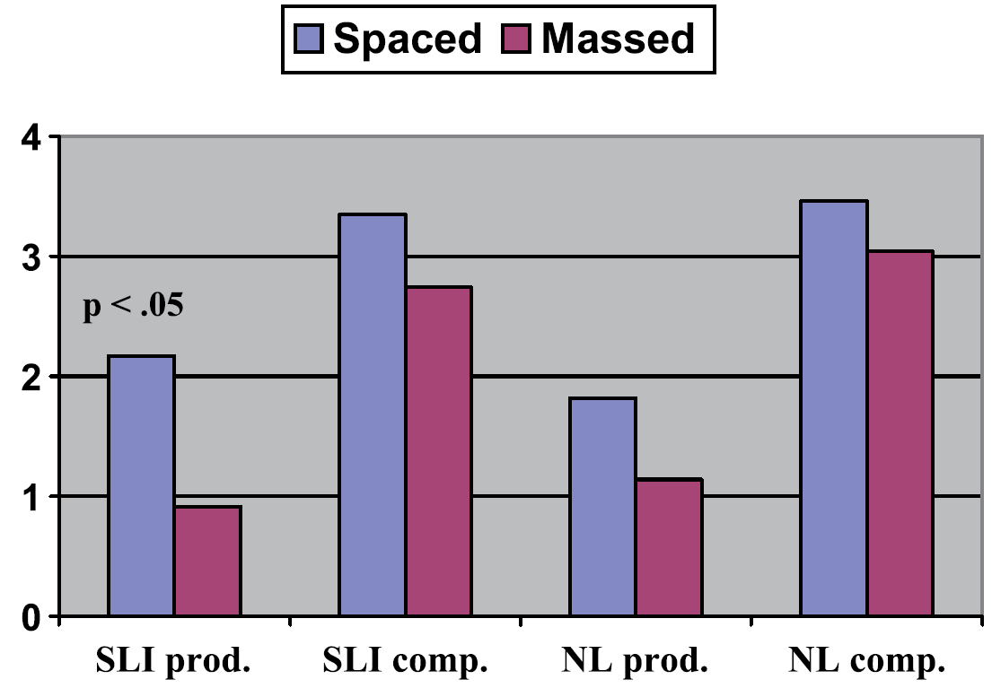
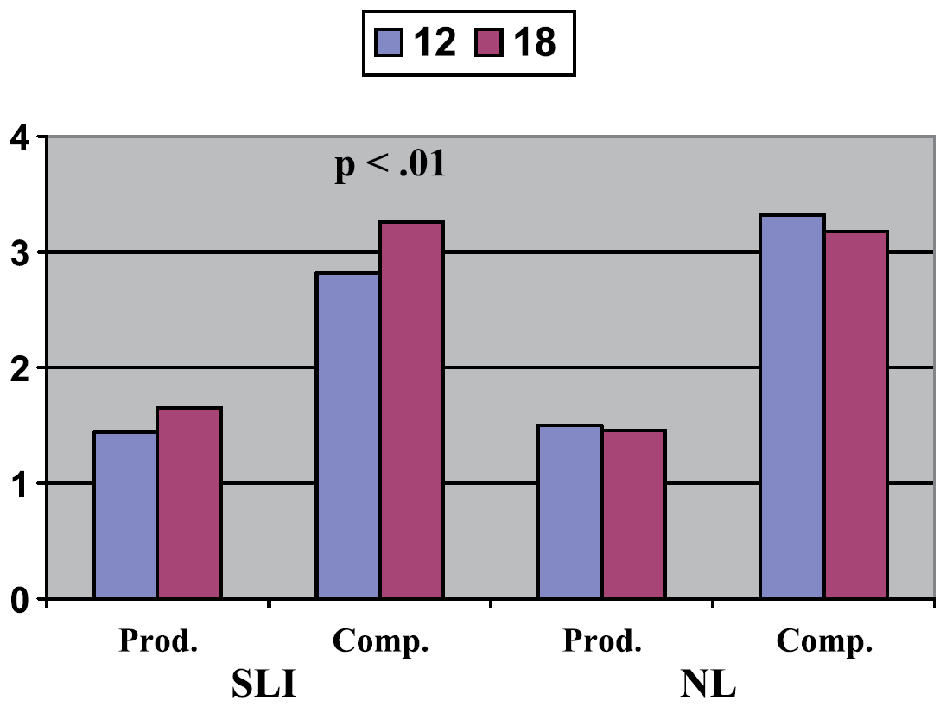
Distributed learning
Linguistic Approaches to Intervention
Distributed learning leads to better retention of words (Riches et al. 2005)
Nick Riches
(1) Multimodal approaches
Definition
Use of shape and colour Use of gesture
Difficulty gradients
What are difficulty gradients?
Difficulty gradients
Lexical variation within slots
Variation versus no variation Skewed distributions
Other psycholinguistic approaches
Distributed learning Active learning
Conclusion Bibliography

Slide 37
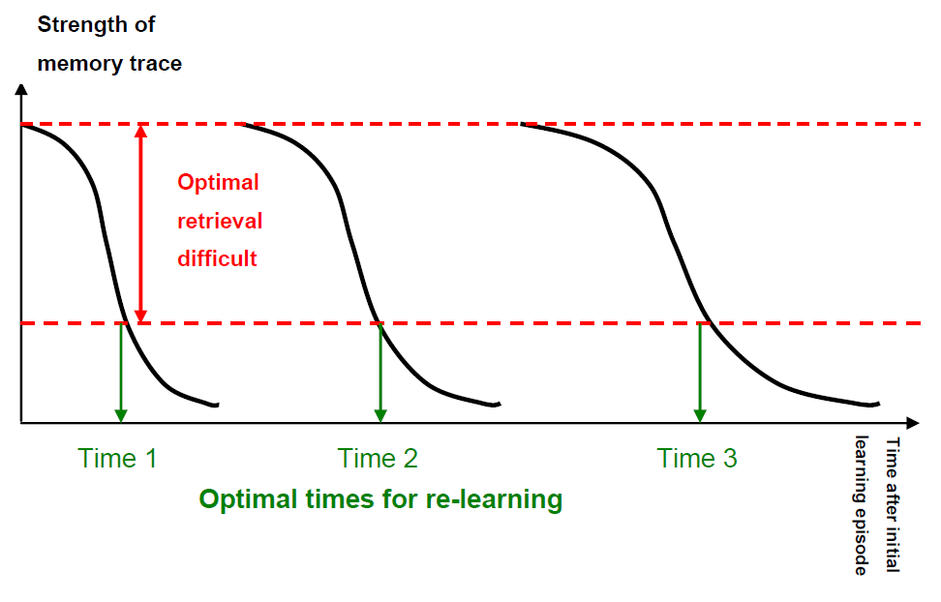
Distributed learning
Linguistic Approaches to Intervention
Nick Riches
Multimodal approaches
Definition
Use of shape and colour Use of gesture
Difficulty gradients
What are difficulty gradients?
Difficulty gradients
Lexical variation within slots
Variation versus no variation Skewed distributions
Other psycholinguistic approaches
Distributed learning Active learning
Conclusion Bibliography

Slide 38
Distributed learning
Linguistic Approaches to Intervention
Nick Riches
(1) Multimodal approaches
Definition
Use of shape and colour Use of gesture
(2) Difficulty gradients
What are difficulty gradients?
Difficulty gradients
But intensive training with short intervals seems to be better for motor learning, e.g. Lee Silverman treatment for Parkinson’s
(3) Lexical variation within slots
Variation versus no variation Skewed distributions
(4) Other psycholinguistic approaches
Distributed learning Active learning
Conclusion Bibliography

Slide 39
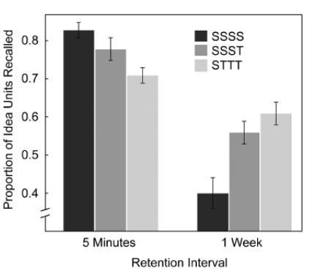
Active learning
Linguistic Approaches to Intervention
We learn better when we learn actively, e.g. we continually test our knowledge of a particular topic, than when we learn passively, e.g. we just read about a topic.
Roediger & Karpicke, 2006
Nick Riches
(1) Multimodal approaches
Definition
Use of shape and colour Use of gesture
Difficulty gradients
What are difficulty gradients?
Difficulty gradients
Lexical variation within slots
Variation versus no variation Skewed distributions
Other psycholinguistic approaches
Distributed learning Active learning
Conclusion Bibliography
31 / 38

Slide 40
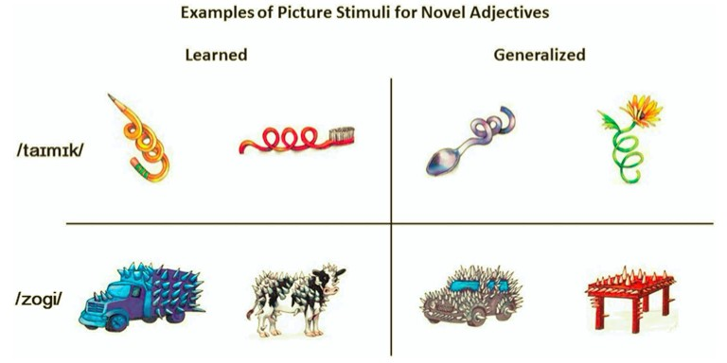
Active learning
Linguistic Approaches to Intervention
Nick Riches
Leonard, 2019 - Retrieval condition versus no-retrieval condition (study only)
Novel adjectives
(1) Multimodal approaches
Definition
Use of shape and colour Use of gesture
(2) Difficulty gradients
What are difficulty gradients?
Difficulty gradients
Lexical variation within slots
Variation versus no variation Skewed distributions
Other psycholinguistic approaches
Distributed learning Active learning
Conclusion Bibliography
32 / 38

Slide 41
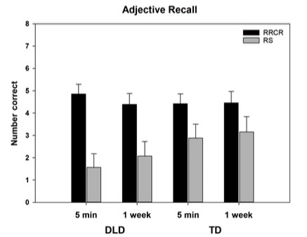
Active learning
Linguistic Approaches to Intervention
Nick Riches
Multimodal approaches
Definition
Use of shape and colour Use of gesture
Difficulty gradients
What are difficulty gradients?
Difficulty gradients
Lexical variation within slots
Variation versus no variation Skewed distributions
Other psycholinguistic approaches
Distributed learning Active learning
Conclusion Bibliography
33 / 38

Slide 42
Linguistic Approaches to Intervention
Nick Riches
(1) Multimodal approaches
Definition
Use of shape and colour Use of gesture
(1) Multimodal approaches
(2) Difficulty gradients
(2) Difficulty gradients
What are difficulty gradients?
Difficulty gradients
(3) Lexical variation within slots
(4) Other psycholinguistic approaches
(3) Lexical variation within slots
Variation versus no variation Skewed distributions
Conclusion Bibliography
(4) Other psycholinguistic approaches
Distributed learning Active learning
Conclusion
Bibliography
33 / 38

Slide 43
Linguistic Approaches to Intervention
Nick Riches
(1) Multimodal approaches
Definition
Use of shape and colour Use of gesture
(2) Difficulty gradients
What are difficulty gradients?
Difficulty gradients
A lot of the language theory we have covered is directly clinically applicable!!!
(3) Lexical variation within slots
Variation versus no variation Skewed distributions
(4) Other psycholinguistic approaches
Distributed learning Active learning
Conclusion Bibliography
34 / 38

Slide 44
Linguistic Approaches to Intervention
Nick Riches
(1) Multimodal approaches
Definition
Use of shape and colour Use of gesture
(1) Multimodal approaches
(2) Difficulty gradients
(2) Difficulty gradients
What are difficulty gradients?
Difficulty gradients
(3) Lexical variation within slots
(4) Other psycholinguistic approaches
(3) Lexical variation within slots
Variation versus no variation Skewed distributions
Conclusion Bibliography
(4) Other psycholinguistic approaches
Distributed learning Active learning
Conclusion
Bibliography
34 / 38

Slide 45
Linguistic Approaches to Intervention
Nick Riches
Bryan, A. (2003). Colourful semantics: Thematic role therapy. Language Disorders in Children and Adults: Psycholinguistic Approaches to Therapy, 143–161.
Casenhiser, D., & Goldberg, A. E. (2005). Fast mapping between a phrasal form and meaning. Developmental Science, 8(6), 500–508.
(1) Multimodal approaches
Definition
Use of shape and colour Use of gesture
Childers, J., & Tomasello, M. (2001). The role of pronouns in young children’s acquisition of the English transitive construction. Developmental Psychology, 37(6), 739–748.
(2) Difficulty gradients
What are difficulty gradients?
Difficulty gradients
Dell, G. S., & Chang, F. (2013). The P-chain: relating sentence production and its disorders to comprehension and acquisition. Philosophical Transactions of the Royal Society B: Biological Sciences, 369(1634). https://doi.org/10.1098/rstb.2012.0394
(3) Lexical variation within slots
Variation versus no variation Skewed distributions
Ebbels, S. H., van der Lely, H. K. J., & Dockrell, J. E. (2007). Intervention for Verb Argument Structure in Children With Persistent SLI: A Randomized Control Trial. Journal of Speech, Language and Hearing Research, 50(5), 1330.
Ebbels, S., & Van der Lely, H. K. J. (2001). Meta-syntactic therapy using visual coding for children with severe persistent SLI. International Journal of Child Language Disorders, 36(s1), 345–350.
(4) Other psycholinguistic approaches
Distributed learning Active learning
Conclusion
Bibliography
35 / 38

Slide 46
Linguistic Approaches to Intervention
Nick Riches
Ebbels, Susan H., Dockrell, J. E., & van der Lely, H. K. J. (2012). Production of change-of-state, change-of-location and alternating verbs: A comparison of children with specific language impairment and typically developing children. Language and Cognitive Processes, 27(9), 1312–1333.
https://doi.org/10.1080/01690965.2011.605598
Ebbels, Susan H., MariA¨, N., Murphy, A., & Turner, G. (2013). Improving comprehension in adolescents with severe receptive language impairments: a randomized control trial of intervention for coordinating conjunctions.
International Journal of Language & Communication Disorders, 1–19.
https://doi.org/10.1111/1460-6984.12047
(1) Multimodal approaches
Definition
Use of shape and colour Use of gesture
(2) Difficulty gradients
What are difficulty gradients?
Difficulty gradients
Gierut, J. A. (2007). Phonological complexity and language learnability. American Journal of Speech-Language Pathology, 16(1), 6.
(3) Lexical variation within slots
Variation versus no variation Skewed distributions
Israel, M., Johnson, C., & Brooks, P. (2000). From states to events: the acquisition of English passive participles. Cognitive Linguistics, 11(1/2), 103–129.
Leonard Laurence B., Deevy Patricia, Karpicke Jeffrey D., Christ Sharon, Weber Christine, Kueser Justin B., & Haebig Eileen. (2019). Adjective Learning in Young Typically Developing Children and Children With Developmental Language Disorder: A Retrieval-Based Approach. Journal of
Speech, Language, and Hearing Research, 62(12), 4433-4449. https://doi.org/10.1044/2019_{J} SLHR − L − 19 − 0221
(4) Other psycholinguistic approaches
Distributed learning Active learning
Conclusion
Bibliography

Slide 47
Linguistic Approaches to Intervention
Nick Riches
Riches, N. G., Tomasello, M., & Conti-Ramsden, G. (2005). Verb learning in children with SLI: frequency and spacing effects. Journal of Speech Language and Hearing Research, 48(6), 1397–1411.
https://doi.org/1092-4388/05/4806-1397
Roediger, H. L., & Karpicke, J. D. (2006). Test-Enhanced Learning. Taking Memory Tests Improves Long-Term Retention. 249ˆa255.
https://doi.org/doi:10.1111/j.1467-9280.2006.01693.x
(1) Multimodal approaches
Definition
Use of shape and colour Use of gesture
(2) Difficulty gradients
What are difficulty gradients?
Difficulty gradients
(3) Lexical variation within slots
Variation versus no variation Skewed distributions
(4) Other psycholinguistic approaches
Distributed learning Active learning
Conclusion
Bibliography

Slide 48
Linguistic Approaches to Intervention
Nick Riches
Theakston, A. L., Coates, A., & Holler, J. (2014). Handling agents and patients: Representational cospeech gestures help children comprehend complex syntactic constructions. Developmental Psychology, 50(7), 1973.
Thompson, C. K., & Shapiro, L. P. (2007). Complexity in Treatment of Syntactic Deficits. American Journal of Speech-Language Pathology, 16(1), 30–42. https://doi.org/10.1044/1058-0360(2007/005)
Van Horne, A. J. O., Fey, M., & Curran, M. (2017). Do the Hard Things First: A Randomized Controlled Trial Testing the Effects of Exemplar Selection on Generalization Following Therapy for Grammatical Morphology. Journal of Speech Language and Hearing Research, 60(9), 2569. https://doi.org/10.1044/2017 JSLHR-L-17-0001
(1) Multimodal approaches
Definition
Use of shape and colour Use of gesture
(2) Difficulty gradients
What are difficulty gradients?
Difficulty gradients
(3) Lexical variation within slots
Variation versus no variation Skewed distributions
(4) Other psycholinguistic approaches
Distributed learning Active learning
Conclusion
Bibliography

